Slide 1
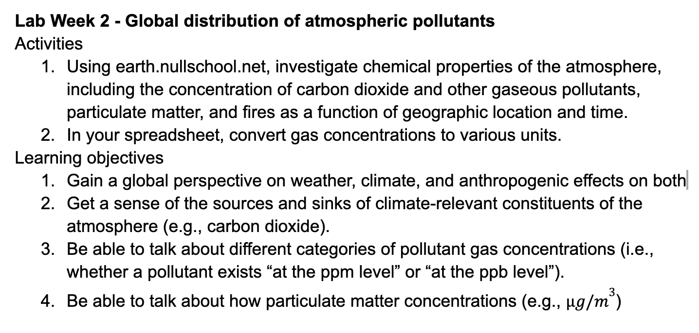
Big picture for lab today

Slide 2
Part 1. Group assignments
Group | Gas | Particulate type
1 | Carbon monoxide (CO) | Dust
2 | Carbon dioxide (CO₂) | PM₁, PM_{2.5}, PM₁₀
3 | Sulfur dioxide (SO₂) | Sulfate
4 | Nitrogen dioxide (NO₂) | Organic Material

Slide 3
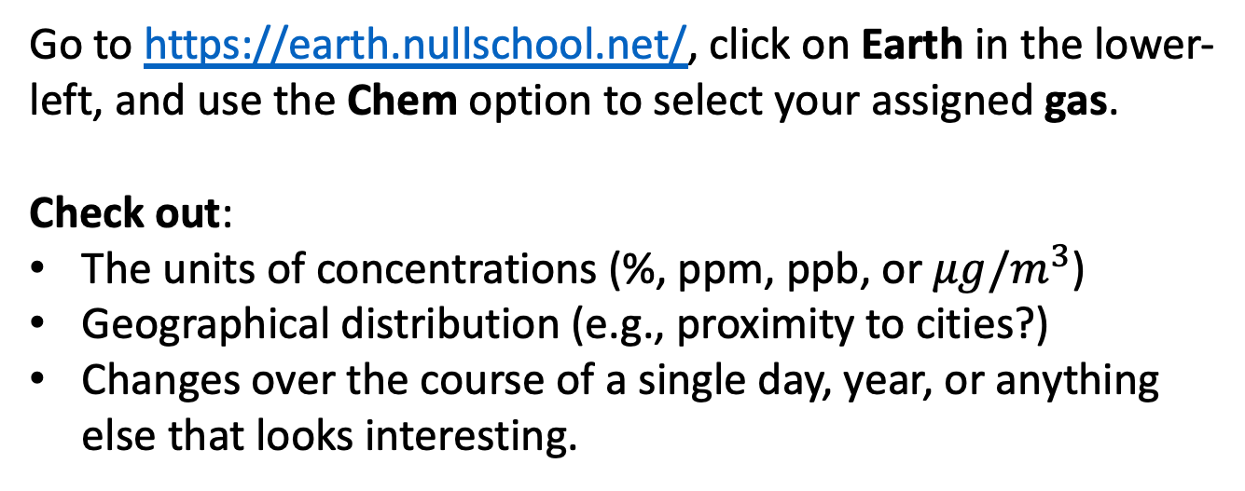
Part 1. Global distribution of air pollutants: Gases
Go to https://earth.nullschool.net/, click on Earth in the lower-left, and use the Chem option to select your assigned gas.
Check out:
The units of concentrations (%, ppm, ppb, or $μg/m^{3}$)
Geographical distribution (e.g., proximity to cities?)
Changes over the course of a single day, year, or anything else that looks interesting.

Slide 4
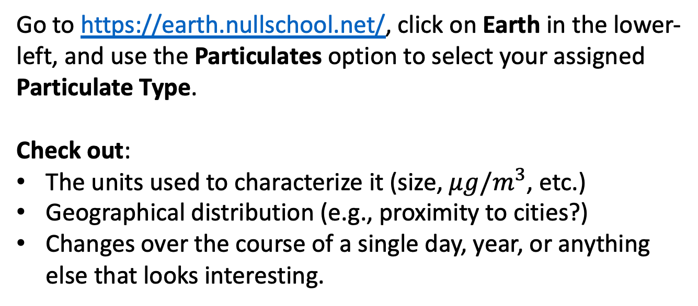
Part 1. Global distribution of air pollutants: Particulates
Go to https://earth.nullschool.net/, click on Earth in the lower-left, and use the Particulates option to select your assigned Particulate Type.
Check out:
The units used to characterize it (size, $μg/m^{3}$, etc.)
Geographical distribution (e.g., proximity to cities?)
Changes over the course of a single day, year, or anything else that looks interesting.

Slide 5
Part 2. Conversions in a spreadsheet
In your shared google sheet document (like this sampler) get to the tab called Gas Concentrations. Also open https://en.wikipedia.org/wiki/Trace_gas. Then,
For CO₂, CH₄, and N₂O:
Enter its concentration in ppm (based on the table*)
Convert to % (divide ppm by 10⁴)
Convert to ppb (multiply ppm by 10³)
For CO, O₃, and SO₂:
Enter its concentration in ppb (based on the table*)
Convert to ppm (divide ppb by 10³)
Convert to % (divide ppm by 10⁴)
*If Wikipedia gives a range of concentrations, choose somewhere in the middle

